Slide 1
Bridges
By Bridget Weiss

Slide 2
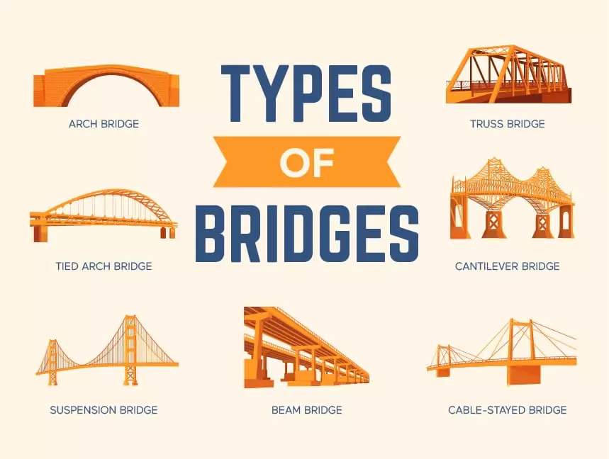
What is a Bridge?

Slide 3
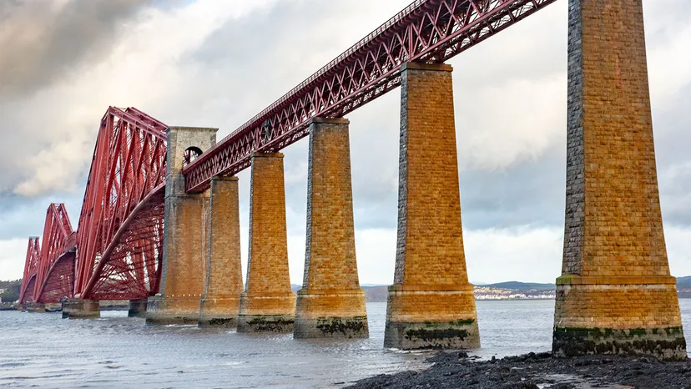
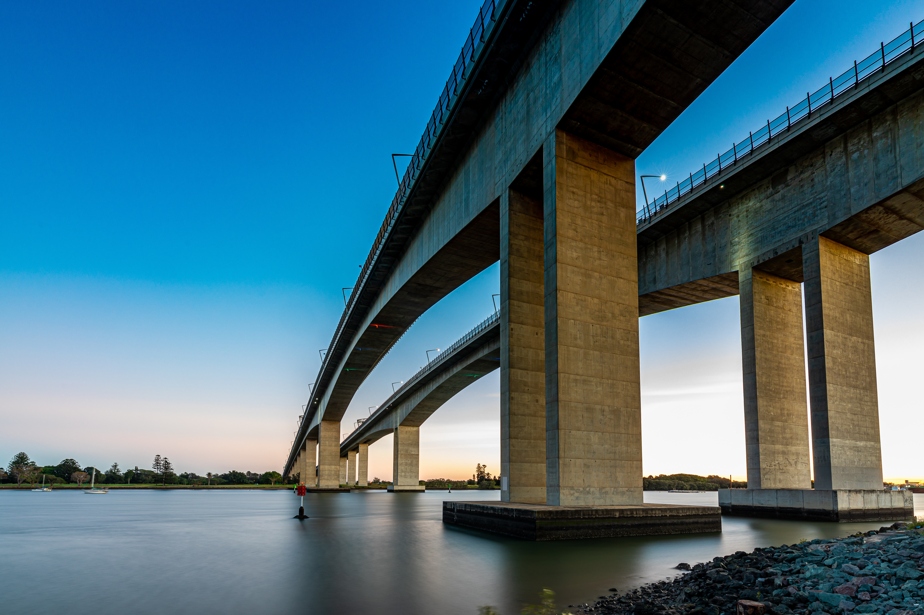
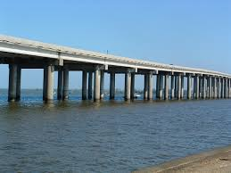
Beam Bridges

Slide 4
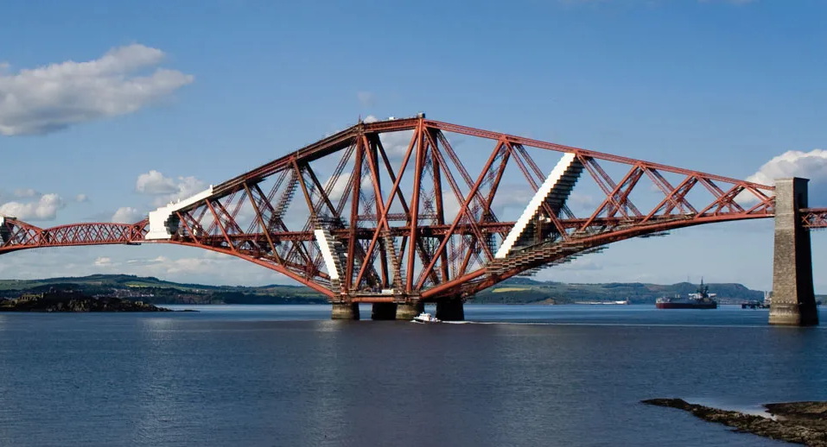
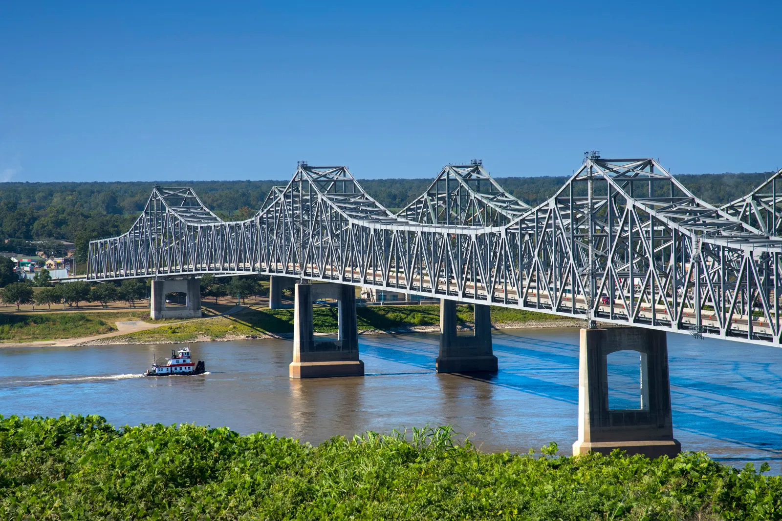
Cantilever Bridges

Slide 5
PART 2
DURING LECTURE NEXT WEEK!

